Slide 1
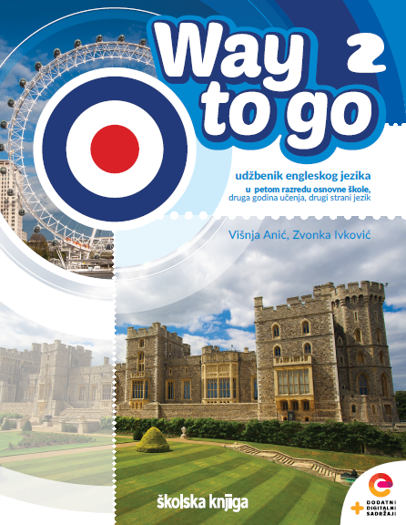

Holidays
Christmas time

Slide 2
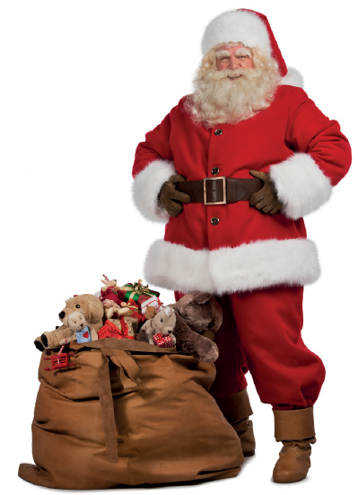
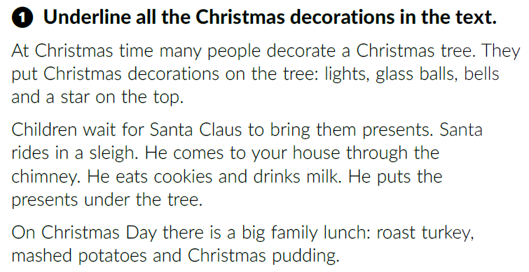
How many words can you name related to Christmas?
Christmas
Textbook, p. 102

Slide 3
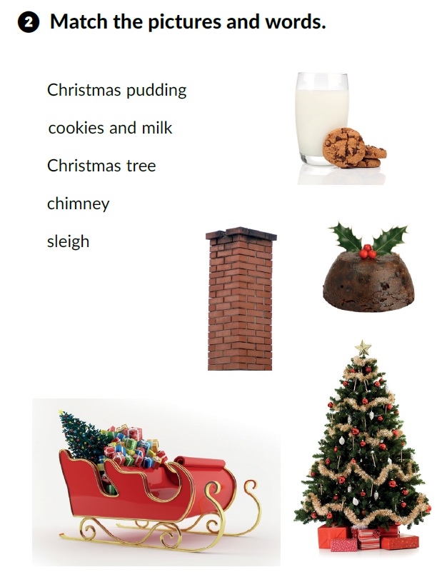

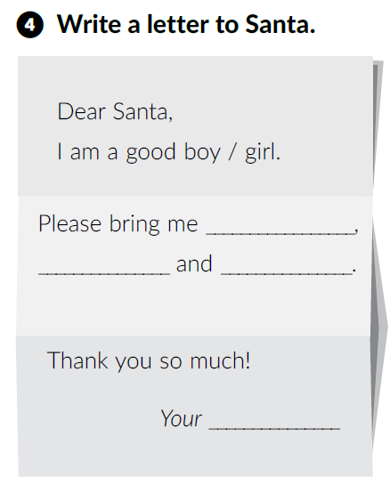
Read the text again and match.

Slide 4
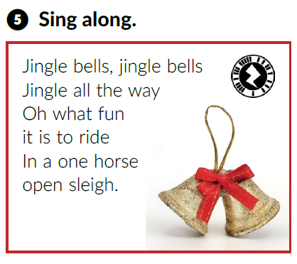

https://www.youtube.com/watch?v=3CWJNqyub3o&ab_channel=ChristmasSongsandCarols-LovetoSing

Slide 5
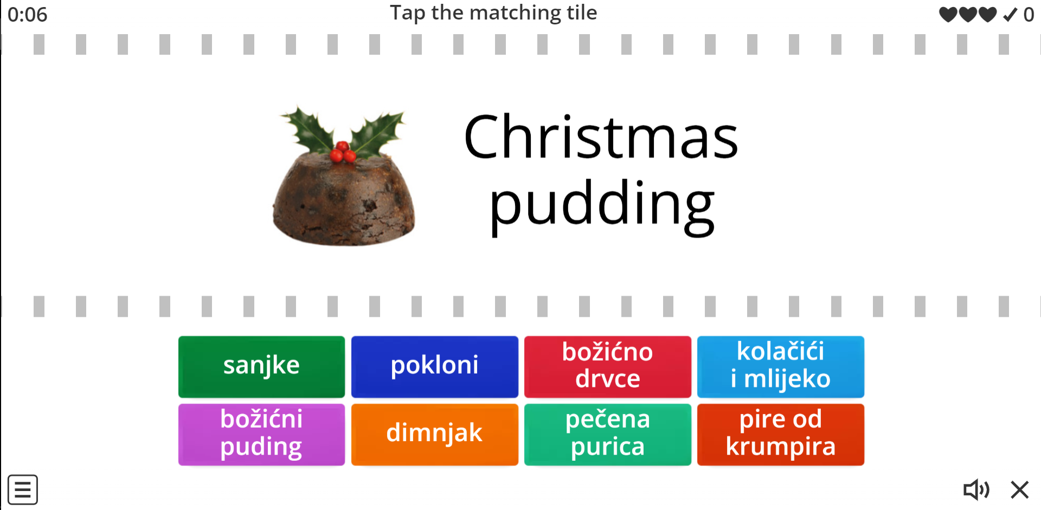
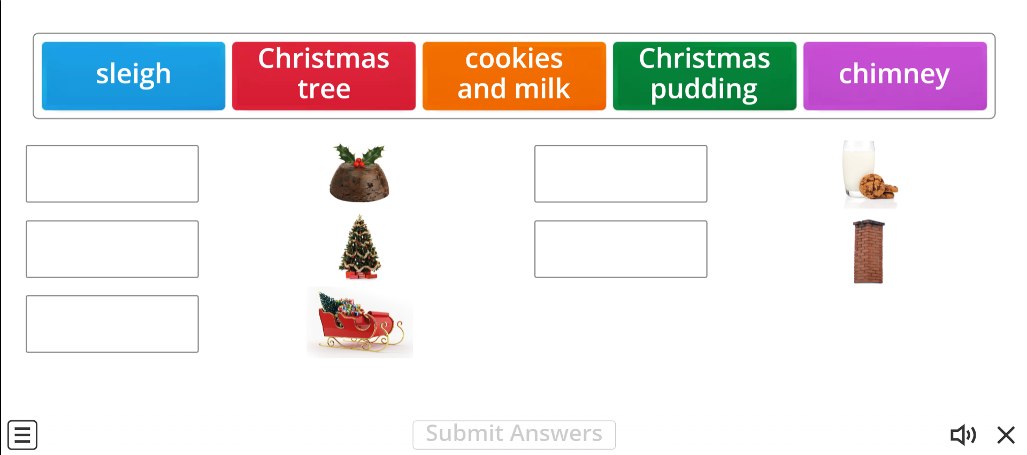
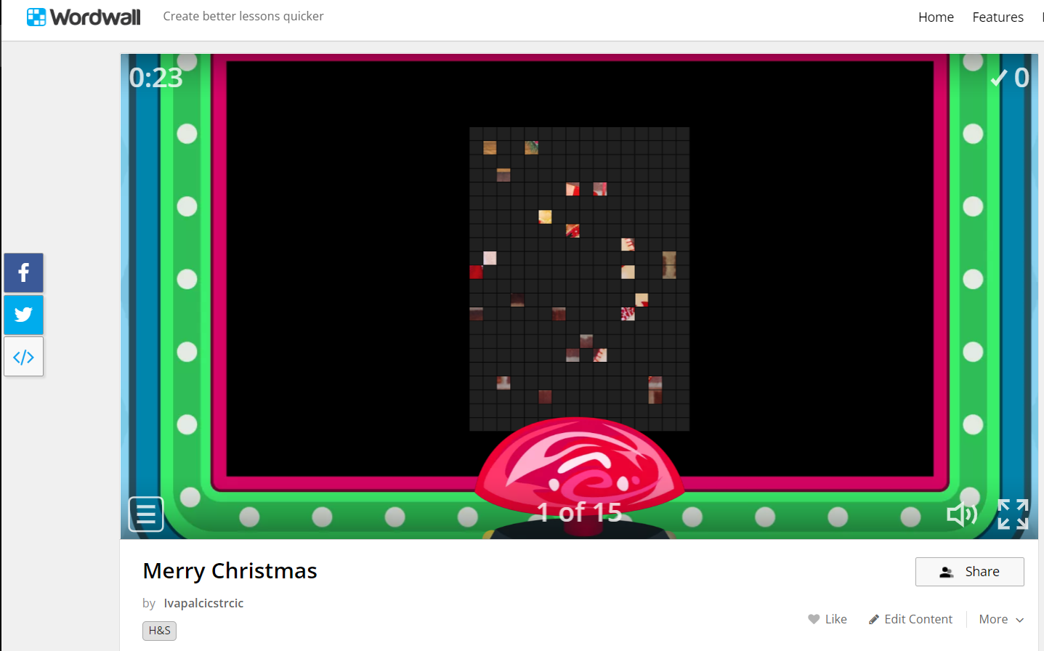
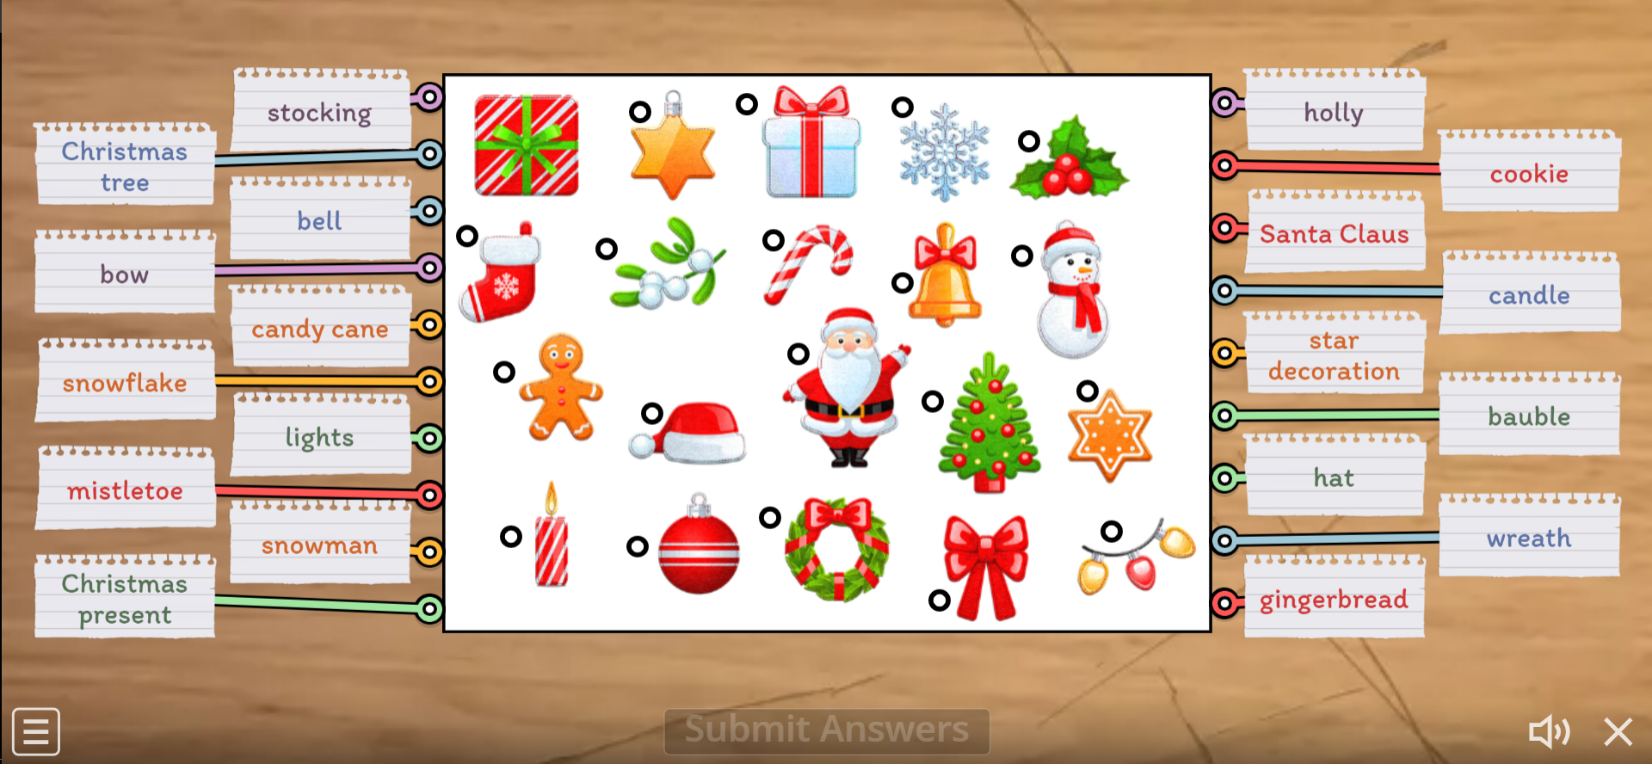
Let’s play!
https://wordwall.net/play/8566/474/557
https://wordwall.net/play/8564/488/717
https://wordwall.net/play/727/187/876
https://wordwall.net/resource/354464/h-s/merry-christmas

